Slide 1

Design of a Low-Cost Social Robot for Children with Complex Communication Needs
Presenter: Sadra Hemmati
Department of Mechanical, Aerospace, and Biomedical Engineering
University of Tennessee
Behavior
Robotics
&Sensing
Group

Slide 2
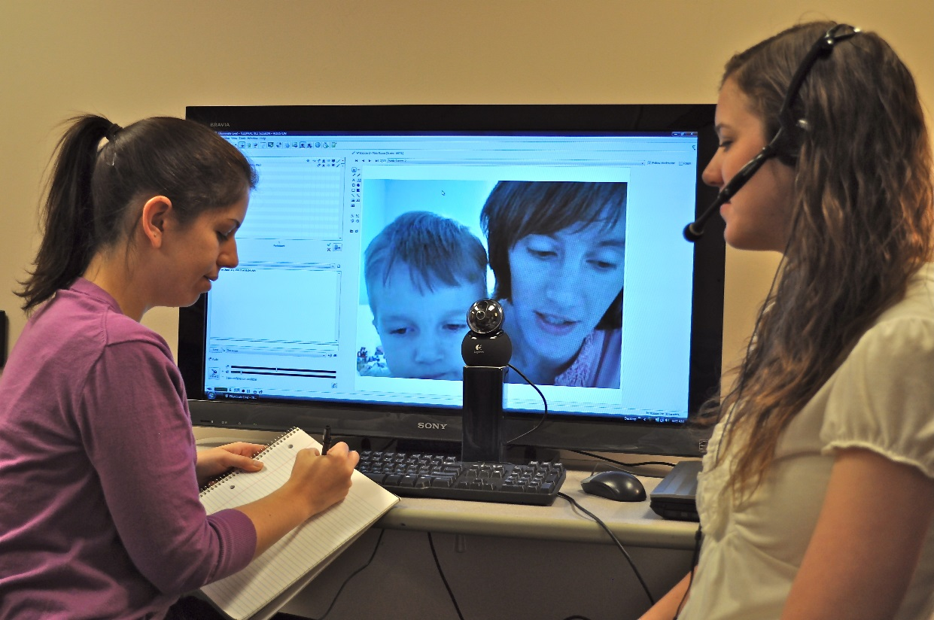
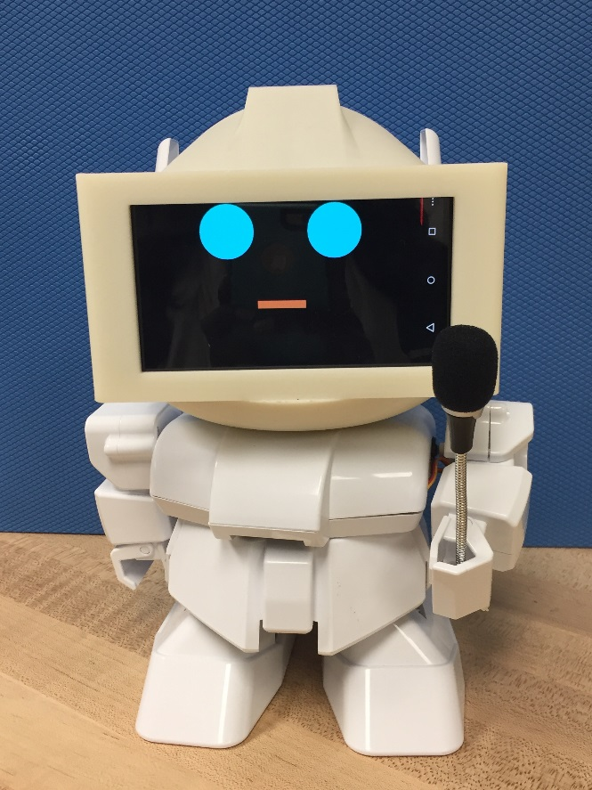
Telehealth for Cochlear Implants
Telehealth interventions for cochlear implant patients
Socially assistive robot for in-home speaking practice
Notes:
Problem:
Each year, 8000 to 12000 children are born with hearing loss in one or both ears.
This hearing loss is problematic because these children may fall behind their peers in language, cognitive, and social skills
Current Approach:
In general, after cochlear implants, children need large amounts of repeated practice of increasing difficulty in order to regain typical hearing and speaking capabilities.
For children in rural and urban settings, telehealth solutions have been developed (Figure). This consists of a parent and child, typically in the home setting, and a clinician located remotely and communicating using the internet.
The problem with this approach is children may lose interest and become distracted.
A system capable of keeping children interested and focused, and providing clinician-driven practice in a standard and repeatable way may be hugely beneficial for long term developmental outcomes.
Our Solution:
Our solution is a socially assistive robot designed to provided in-home speaking practice for children with cochlear implants. This robot consists of:
A social robot capable of simple gestures.
A smartphone with custom software used as the robot’s face.
A custom 3D-printed head to hold the smartphone in place.
Figure reference (http://cochlearimplantonline.com/site/wp-content/uploads/2012/07/Anne_Kelly_TELL.jpg)

Slide 3
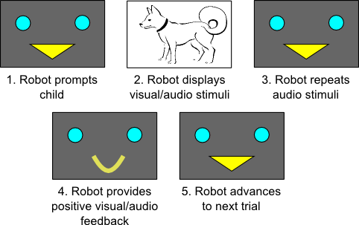
Social Robotics for Cochlear Implant Patients
Telehealth intervention requirements
Telehealth robot behaviors (displayed on face/smartphone)
Prompt child using images and videos
Provide intervention–specific stimuli
Ensure that the child’s voice can be heard
Contingently guide child through the interaction
Notes:
Requirements for Telehealth
The role of the robot is based directly on existing telehealth interventions. Current telehealth requirements include:
Prompting the child with an image, such as a DOG.
Providing specific stimuli to the child, such as “please say the word DOG.”
Ensuring that the child verbalizes the appropriate phrase.
Given the child provides the proper response, advancing to the next image/word combination.
Robot Behavior
These robot behaviors are depicted by the images displayed on the smartphone.
First, the robot prompts the child using a friendly, smiling face.
Next, the robot displays an image associated with the relevant word.
Next, the robot verbalizes the associated word (“Dog”).
Next, the robot uses speech recognition to determine when the child verbalizes.
Finally, the robot provides positive feedback and advances to the next image/word combination.
The robot also moves its arms and performs simple gestures to maintain engagement with the children.

Slide 4
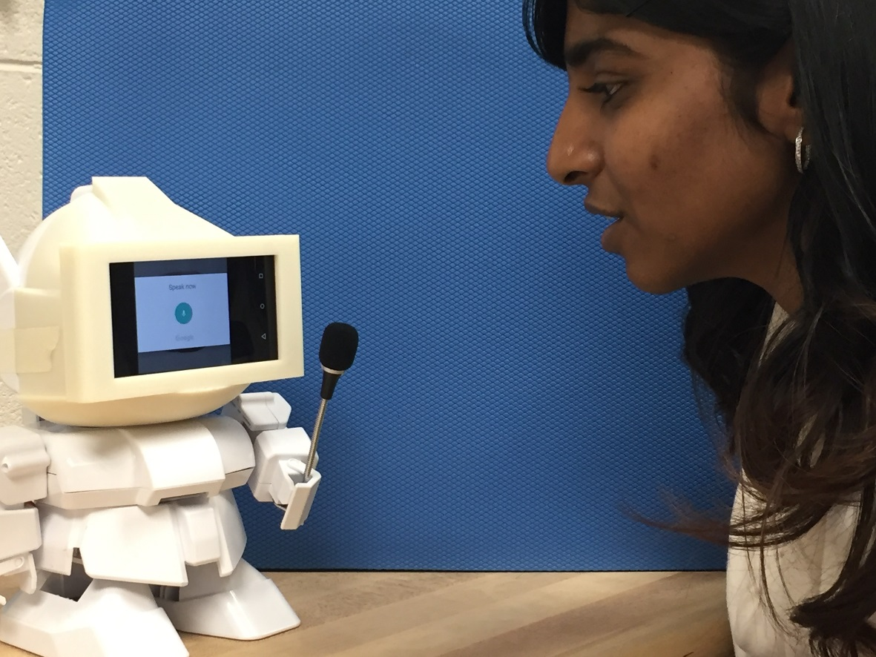
Our Approach
Final version of constructed system
Results of interaction with children in noisy environment
5 students successfully performed the interaction
System performed in noisy environment
Total system cost is under $750
Notes:
Final System:
Our final system is shown in the FIGURE. The robot performs the required steps. It performs basic gestures (moving the arm with a microphone) to engage the child participant.
Results:
We tested the system with 5 students who were successfully guided through the interaction.
The system worked in a fairly noisy environment (students and teachers speaking in the background).
The total system cost is under $750, which may be beneficial for wide implementation. Full commercialization of this system my further reduce the cost.
Future work will validate the system with children with cochlear implants (Summer 2016).

